Slide 1
Introduction to CUDA Programming
Optimizing for CUDA
Andreas Moshovos
Winter 2009
Most slides/material from:
UIUC course by Wen-Mei Hwu and David Kirk
Mark Haris NVIDIA

Slide 2
Hardware recap
Thread Processing Clusters
  3 Stream Multiprocessors
  Texture Cache
Stream Multiprocessors
  8 Stream Processors
  2 Special Function Units
  1 Double-Precision Unit
  16K Shared Memory / 16 Banks / 32bit interleaved
  16K Registers
  32 thread warps
Constant memory
  64KB in DRAM / Cached
Main Memory
  1GByte
  512 bit interface
  16 Banks

Slide 3
WARP
Minimum execution unit
  32 Threads
  Same instruction
  Takes 4 cycles
    8 thread per cycle
  Think of memory operating in half the speed
    The first 16 threads go in parallel to memory
    The next 16 do the same
    Half-warp:
      Coalescing possible

Slide 4
WARP
THREAD
WARP EXECUTION
Memory References
Half-Warp

Slide 5
WARP: When a thread stalls
THREAD
Thread 1
stall
Thread 2
Thread 1
Thread 2

Slide 6
Limits on # of threads
Grid and block dimension restrictions
  Grid: 64k x 64k
  Block: 512x512x64
  Max threads/block = 512
A block maps onto an SM
  Up to 8 blocks per SM
Every thread uses registers
  Up to 16K regs
Every block uses shared memory
  Up to 16KB shared memory
Example:
  16x16 blocks of threads using 20 regs each
  Each block uses 4K of shared memory
    5120 registers / block → 3.2 blocks/SM
    4K shared memory/block → 4 blocks/SM

Slide 7
Understanding Control Flow Divergence
if (in[i] == 0) out[i] = sqrt(x);
else out[i] = 10;
WARP
in[i] == 0
in[i] == 0
idle
TIME
out[i] = sqrt(x)
out[i] = 10

Slide 8
Control Flow Divergence Contd.
WARP
WARP #1
WARP #2
in[i] == 0
in[i] == 0
in[i] == 0
idle
TIME
BAD SCENARIO
Good Scenario

Slide 9
Instruction Performance
Instruction processing steps per warp:
  Read input operands for all threads
  Execute the instruction
  Write the results back
For performance:
  Minimize use of low throughput instructions
  Maximize use of available memory bandwidth
  Allow overlapping of memory accesses and computation
    High compute/access ratio
    Many threads

Slide 10
Instruction Throughput not Latency
4 Cycles
  Single precision FP:
    ADD, MUL, MAD
  Integer
    ADD, __mul24(x), __umul24(x)
  Bitwise, compare, min, max, type conversion
16 Cycles
  Reciprocal, reciprocal sqrt, __logf(x)
  32-bit integer MUL
    Will be faster in future hardware
20 Cycles
  __fdividef(x)
32 Cycles
  Sqrt(x) = 1/sqrt(x) → 1/that
  __sinf(x), __cosf(x), __exp(x)
36 Cycles
  Single fp div
Many more
  Sin() (10x if x > 48039), integer div/mod,

Slide 11
Optimization Steps
Optimize Algorithms for the GPU
Optimize Memory Access Ordering for Coalescing
Take Advantage of On-Chip Shared Memory
Use Parallelism Efficiently

Slide 12
Optimize Algorithms for the GPU
Maximize independent parallelism
  We’ll see more of this with examples
  Avoid thread synchronization as much as possible
Maximize arithmetic intensity (math/bandwidth)
  Sometimes it’s better to re-compute than to cache
  GPU spends its transistors on ALUs, not memory
  Do more computation on the GPU to avoid costly data transfers
  Even low parallelism computations can sometimes be faster than transferring back and forth to host

Slide 13
Optimize Memory Access Ordering for Coalescing
Coalesced Accesses:
  A single access for all requests in a half-warp
Coalesced vs. Non-coalesced
  Global device memory
    order of magnitude
  Shared memory
    # of bank conflicts

Slide 14
Exploit the Shared Memory
Hundreds of times faster than global memory
  2 cycles vs. 400-600 cycles
Threads can cooperate via shared memory
  __syncthreads ()
Use it to avoid non-coalesced access
  Stage loads and stores in shared memory to re-order non-coalesceable addressing
  Matrix transpose example later

Slide 15
Use Parallelism Efficiently
Partition your computation to keep the GPU multiprocessors equally busy
  Many threads, many thread blocks
Keep resource usage low enough to support multiple active thread blocks per multiprocessor
  Registers, shared memory

Slide 16
Global Memory Reads/Writes
Highest latency instructions:
  400-600 clock cycles
Likely to be performance bottleneck
  Optimizations can greatly increase performance
  Coalescing: up to 10x speedup
  Latency hiding: up to 2.5x speedup

Slide 17
Coalescing
A coordinated read by a half-warp (16 threads)
  Becomes a single wide memory read
All accesses must fall into a continuous region of :
  32 bytes – each thread reads a byte: char
  64 bytes – each thread reads a half-word: short
  128 bytes - each thread reads a word: int, float, …
  128 bytes - each thread reads a double-word: double, int2, float2, …
  128 bytes – each thread reads a quad-word: float4, int4,…
  Additional restrictions on G8X architecture:
    Starting address for a region must be a multiple of region size
    The kth thread in a half-warp must access the kth element in a block being read
  Exception: not all threads must be participating
    Predicated access, divergence within a halfwarp

Slide 18
Coalescing
THREAD
WARP EXECUTION
Memory References
Half-Warp
Must all fall into the same region
  32 bytes – each thread reads a byte: char
  64 bytes – each thread reads a half-word: short
  128 bytes - each thread reads a word: int, float, …
  128 bytes - each thread reads a double-word: double, int2, float2, …

Slide 19
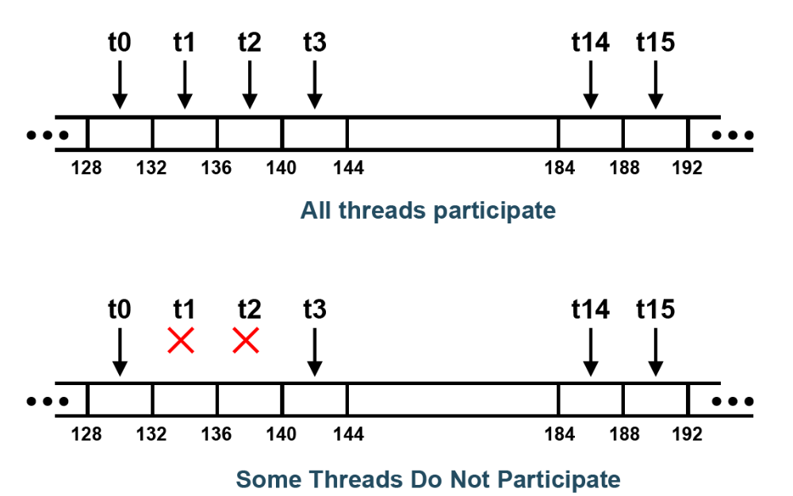
Coalesced Access: Reading Floats
Must all be in a region of 64 bytes
Good
Good

Slide 20
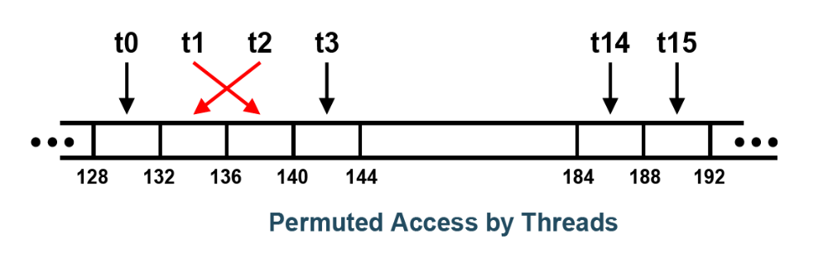
Coalesced Reads: Floats
Good
Overlapping Accesses

Slide 21
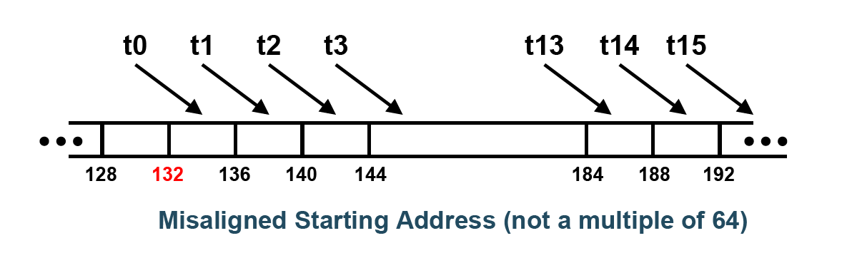
Coalesced Read: Floats
Good
Bad
128
different 128 byte blocks

Slide 22
Coalescing Algorithm
Lowest # thread’s address --> segment
Segment size:
  32 bytes / 8-bit, 64 bytes / 16-bit data, 128 bytes / 32-, 64- and 128-bit.
Which active threads access the same segment?
Reduce the transaction size, if possible:
  Segment 128 bytes and only the lower or upper half is used, transaction becomes 64 bytes;
  Segment 64 bytes and only the lower or upper half is used, transaction becomes 32 bytes.
Perform the transcaction / Mark serviced threads inactive
Repeat until all threads in the half-warp are serviced.

Slide 23
Coalescing Experiment
Kernel:
  Read float, increment, write back: a[i]++;
  3M floats (12MB)
  Times averaged over 10K runs
12K blocks x 256 threads/block
  Coalesced:
    211 μs
      a[i]++
  Coalesced / some don’t participate
    3 out of 4 participate
      if (index & 0x3 != 0) a[i]++
    212 μs
  Coalesced / non-contiguous accesses
    Every two access the same
    212 μs
      a[i & ~1]++;
  Uncoalesced / outside the region
    Every 4 access a[0]
    5,182 μs→ 24.4x slowdown: 4x from uncoalescing and another 8x from contention for a[0]
      if (index & 0x3 == 0) a[0]++;
      else a[i]++;
    785 μs→ 4x slowdown: from not coalescing
      If (index & 0x3) != 0) a[i]++; else a[startOfBlock]++;

Slide 24
Coalescing Experiment Code
for (int i = 0; i < TIMES; i++) {
cutResetTimer(timer); cutStartTimer(timer);
kernel <<<n_blocks, block_size>>> (a_d);
cudaThreadSynchronize (); cutStopTimer (timer);
total_time += cutGetTimerValue (timer);
}
printf (“Time %f\n”, total_time / TIMES);
__global__ void kernel (float *a)
{
int i = blockIdx.x * blockDim.x + threadIdx.x;
a[i]++;
if ((i & 0x3) != 00) a[i]++;
a[i & ~1]++;
if ((i & 0x3) != 00) a[i]++;
else a[0]++;
if (index & 0x3) != 0) a[i]++;
else a[blockIdx.x * blockDim.x]++;
    211 μs
    212 μs
    212 μs
    5,182 μs
    785 μs

Slide 25
Uncoalesced float3 access code
__global__ void
accessFloat3(float3 *d_in, float3 d_out)
{
int index = blockIdx.x * blockDim.x + threadIdx.x;
float3 a = d_in[index];
a.x += 2;
a.y += 2;
a.z += 2;
d_out[index] = a;
}
Execution time: 1,905 μs
12M float3
Averaged over 10K runs

Slide 26
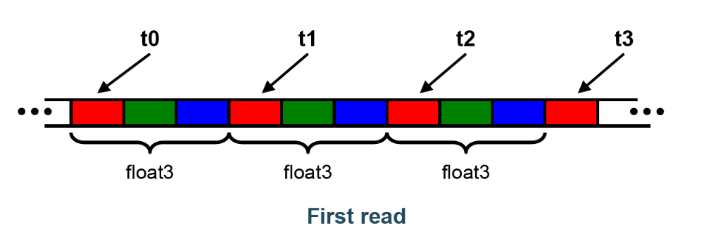
Naïve float3 access sequence
float3 is 12 bytes
  Each thread ends up executing 3 32bit reads
  sizeof(float3) = 12
  Offsets:
    0, 12, 24, …, 180
  Regions of 128 bytes
  Half-warp reads three 64B non-contiguous regions

Slide 27
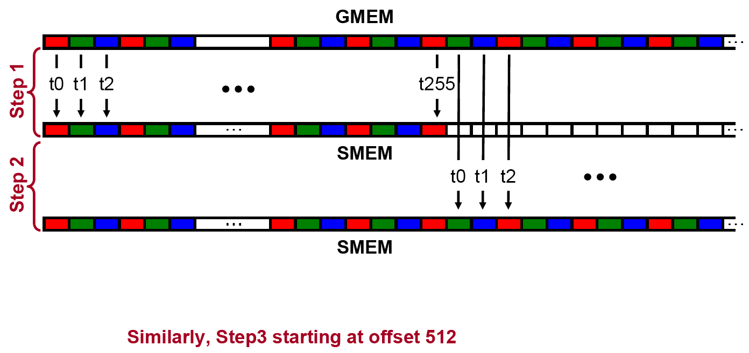
Coalescing float3 access

Slide 28
Coalsecing float3 strategy
Use shared memory to allow coalescing
  Need sizeof(float3)*(threads/block) bytes of SMEM
Three Phases:
  Phase 1: Fetch data in shared memory
    Each thread reads 3 scalar floats
    Offsets: 0, (threads/block), 2*(threads/block)
    These will likely be processed by other threads, so sync
  Phase 2: Processing
    Each thread retrieves its float3 from SMEM array
    Cast the SMEM pointer to (float3*)
    Use thread ID as index
    Rest of the compute code does not change
  Phase 3: Write results back to global memory
    Each thread writes 3 scalar floats
    Offsets: 0, (threads/block), 2*(threads/block)

Slide 29
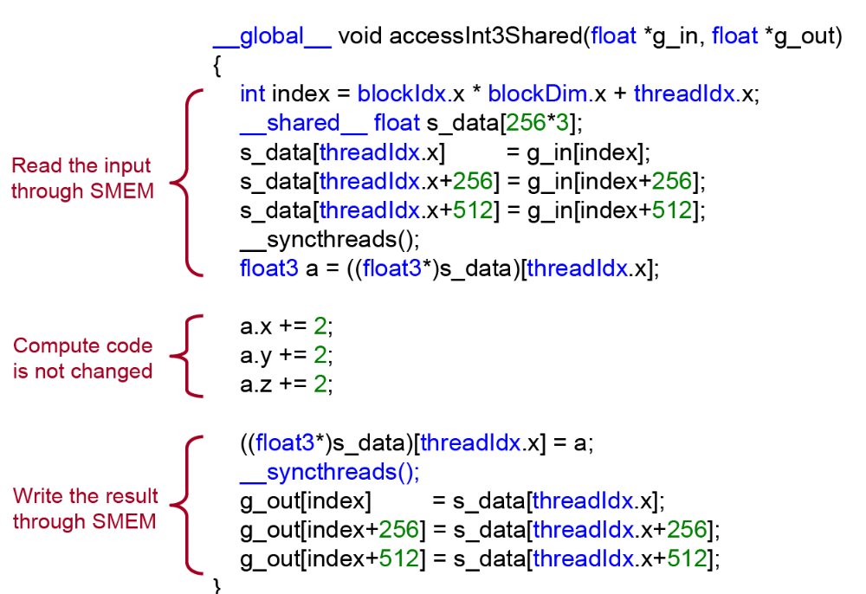
Coalesing float3 access code

Slide 30
Coalesing Experiment: float3
Experiment:
  Kernel: read a float3, increment each element, write back
  1M float3s (12MB)
  Times averaged over 10K runs
  4K blocks x 256 threads:
    648μs – float3 uncoalesced
      About 3x over float code
      Every half-warp now ends up making three refs
    245μs – float3 coalesced through shared memory
      About the same as the float code

Slide 31
Global Memory Coalescing Summary
Coalescing greatly improves throughput
Critical to small or memory-bound kernels
  Reading structures of size other than 4, 8, or 16 bytes will break coalescing:
    Prefer Structures of Arrays over Arrays of Structures
  If SoA is not viable, read/write through SMEM
Future-proof code:
  coalesce over whole warps

Slide 32
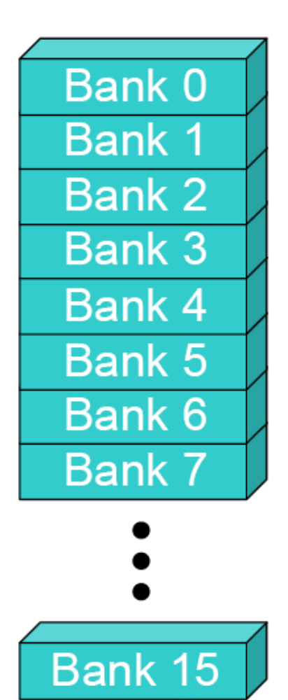
Shared Memory
In a parallel machine, many threads access memory
  Therefore, memory is divided into banks
  Essential to achieve high bandwidth
Each bank can service one address per cycle
  A memory can service as many simultaneous accesses as it has banks
Multiple simultaneous accesses to a bank result in a bank conflict
  Conflicting accesses are serialized

Slide 33
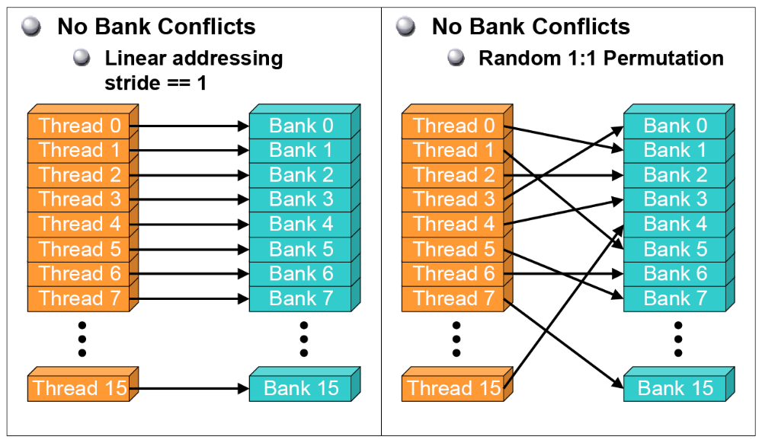
Bank Addressing Examples

Slide 34
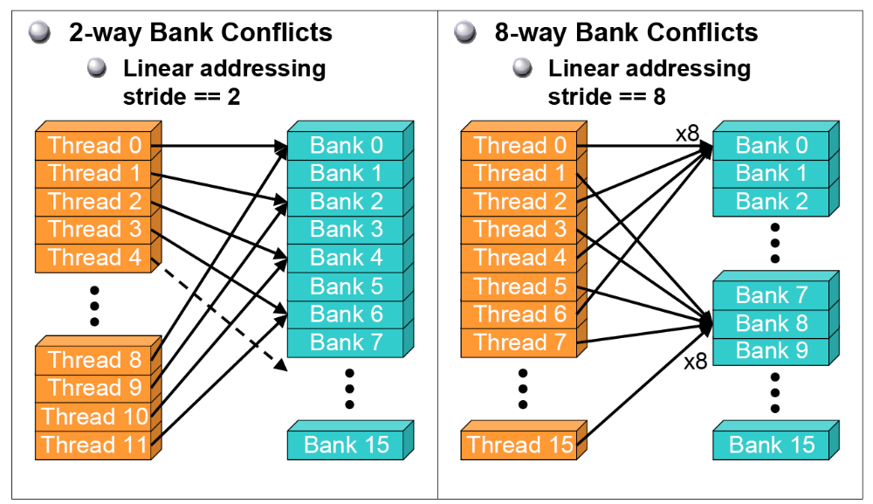
Bank Addressing Examples

Slide 35
How Addresses Map to Banks on G200
Each bank has a bandwidth of 32 bits per clock cycle
Successive 32-bit words are assigned to successive banks
G200 has 16 banks
  So bank = address % 16
  Same as the size of a half-warp
    No bank conflicts between different half-warps, only within a single half-warp

Slide 36
Shared Memory Bank Conflicts
Shared memory is as fast as registers if there are no bank conflicts
  The fast case:
    If all threads of a half-warp access different banks, there is no bank conflict
    If all threads of a half-warp read the same address, there is no bank conflict (broadcast)
  The slow case:
    Bank Conflict: multiple threads in the same half-warp access the same bank
    Must serialize the accesses
    Cost = max # of simultaneous accesses to a single bank

Slide 37
Linear Addressing
Given:
__shared__ float shared[256];
float foo =
shared[baseIndex + s * threadIdx.x];
This is only bank-conflict-free if s shares no common factors with the number of banks
  16 on G200, so s must be odd
s=1
Thread 0
Bank 0
Thread 1
Bank 1
Thread 2
Bank 2
Thread 3
Bank 3
Thread 4
Bank 4
Thread 5
Bank 5
Thread 6
Bank 6
Thread 7
Bank 7
Thread 15
Bank 15
s=3
Thread 0
Bank 0
Thread 1
Bank 1
Thread 2
Bank 2
Thread 3
Bank 3
Thread 4
Bank 4
Thread 5
Bank 5
Thread 6
Bank 6
Thread 7
Bank 7
Thread 15
Bank 15

Slide 38
Linear Addressing
s | 0 | 1 | 2 | 3 | 4 | 5 | 6 | 7 | 8 | 9 | 10 | 11 | 12 | 13 | 14 | 15
3 | 0 | 3 | 6 | 9 | 12 | 15 | 2 | 5 | 8 | 11 | 14 | 1 | 4 | 7 | 10 | 13
5 | 0 | 5 | 10 | 15 | 4 | 9 | 14 | 3 | 8 | 13 | 2 | 7 | 1 2 | 1 | 6 | 11
7 | 0 | 7 | 14 | 5 | 12 | 3 | 10 | 1 | 8 | 15 | 6 | 13 | 4 | 11 | 2 | 9
9 | 0 | 9 | 2 | 11 | 4 | 13 | 6 | 15 | 8 | 1 | 10 | 3 | 12 | 5 | 14 | 7

Slide 39
Data types and bank conflicts
This has no conflicts if type of shared is 32-bits:
foo = shared[baseIndex + threadIdx.x]
But not if the data type is smaller
4-way bank conflicts:
  __shared__ char shared[];
  foo = shared[baseIndex + threadIdx.x];
2-way bank conflicts:
  __shared__ short shared[];
  foo = shared[baseIndex + threadIdx.x];
Thread 0
Bank 0
Thread 1
Bank 1
Thread 2
Bank 2
Thread 3
Bank 3
Thread 4
Bank 4
Thread 5
Bank 5
Thread 6
Bank 6
Thread 7
Bank 7
Thread 15
Bank 15
Thread 0
Bank 0
Thread 1
Bank 1
Thread 2
Bank 2
Thread 3
Bank 3
Thread 4
Bank 4
Thread 5
Bank 5
Thread 6
Bank 6
Thread 7
Bank 7
Thread 15
Bank 15

Slide 40
Structs and Bank Conflicts
Struct assignments compile into as many memory accesses as there are struct members:
  struct vector { float x, y, z; };
  struct myType { float f; int c; };
  __shared__ struct vector vectors[64];
  __shared__ struct myType myTypes[64];
This has no bank conflicts for vector; struct size is 3 words
  3 accesses per thread, contiguous banks (no common factor with 16)
  struct vector v = vectors[baseIndex + threadIdx.x];
This has 2-way bank conflicts for myType;
  (2 accesses per thread)
  struct myType m = myTypes[baseIndex + threadIdx.x];
Thread 0
Bank 0
Thread 1
Bank 1
Thread 2
Bank 2
Thread 3
Bank 3
Thread 4
Bank 4
Thread 5
Bank 5
Thread 6
Bank 6
Thread 7
Bank 7
Thread 15
Bank 15

Slide 41
Common Array Bank Conflict Patterns 1D
Each thread loads 2 elements into shared mem:
  2-way-interleaved loads result in
  2-way bank conflicts:
int tid = threadIdx.x;
shared[2*tid] = global[2*tid];
shared[2*tid+1] = global[2*tid+1];
This makes sense for traditional CPU threads, locality in cache line usage and reduced sharing traffic.
  Not in shared memory usage where there is no cache line effects but banking effects
Thread 0
Bank 0
Thread 1
Bank 1
Thread 2
Bank 2
Thread 3
Bank 3
Thread 4
Bank 4
Bank 5
Bank 6
Bank 7
Thread 8
Thread 9
Thread 10
Thread 11
Bank 15

Slide 42
A Better Array Access Pattern
Each thread loads one element in every consecutive group of blockDim elements.
Thread 0
Bank 0
Thread 1
Bank 1
Thread 2
Bank 2
Thread 3
Bank 3
Thread 4
Bank 4
Thread 5
Bank 5
Thread 6
Bank 6
Thread 7
Bank 7
Thread 15
Bank 15
  shared[tid] = global[tid];
  shared[tid + blockDim.x] = global[tid + blockDim.x];

Slide 43
Common Bank Conflict Patterns (2D)
Operating on 2D array of floats in shared memory
  e.g., image processing
Example: 16x16 block
  Each thread processes a row
  So threads in a block access the elements in each column simultaneously (example: row 1 in purple)
  16-way bank conflicts: rows all start at bank 0
Solution 1) pad the rows
  Add one float to the end of each row
Solution 2) transpose before processing
  Suffer bank conflicts during transpose
  But possibly save them later
Bank Indices without Padding
0
1
2
3
4
5
6
7
15
0
1
2
3
4
5
6
7
15
0
1
2
3
4
5
6
7
15
0
1
2
3
4
5
6
7
15
0
1
2
3
4
5
6
7
15
0
1
2
3
4
5
6
7
15
0
1
2
3
4
5
6
7
15
0
1
2
3
4
5
6
7
15
0
1
2
3
4
5
6
7
15
Bank Indices with Padding
0
1
2
3
4
5
6
7
15
0
1
2
3
4
5
6
7
8
0
1
2
3
4
5
6
7
8
9
1
2
3
4
5
6
7
8
9
10
2
3
4
5
6
7
8
9
10
11
3
4
5
6
7
8
9
10
11
12
4
5
6
7
8
9
10
11
12
13
5
6
7
8
9
10
11
12
13
14
7
8
15
0
1
2
3
4
5
6
14
15

Slide 44
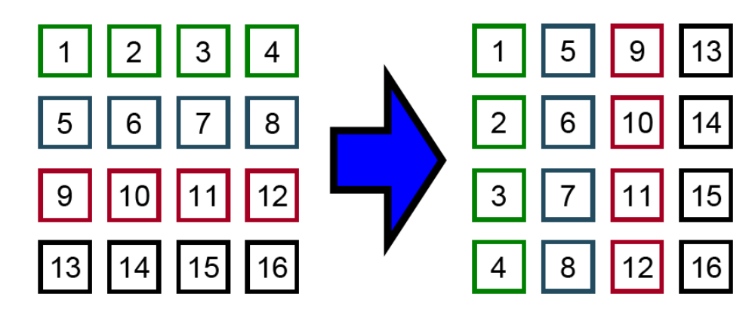
Matrix Transpose
SDK Sample (“transpose”)
  Illustrates: Coalescing
  Avoiding shared memory bank conflicts

Slide 45
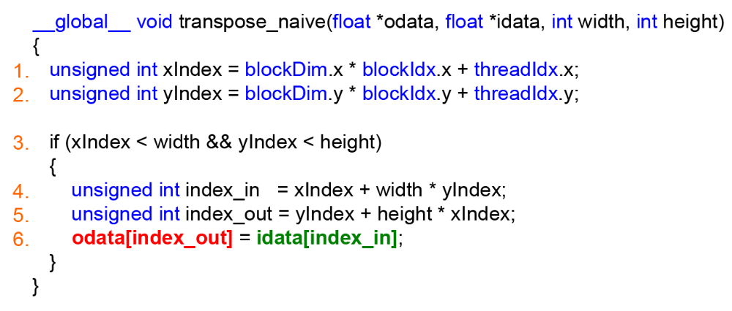
Uncoalesced Transpose

Slide 46
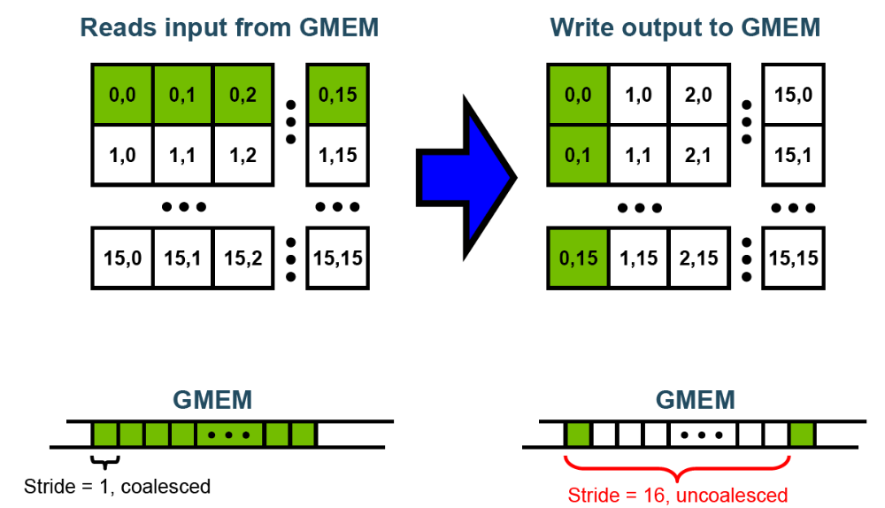
Uncoalesced Transpose: Memory Access Pattern

Slide 47
Coalesced Transpose
Conceptually partition the input matrix into partitioned into square tiles
Threadblock (bx, by):
  Read the (bx,by) input tile, store into SMEM
  Write the SMEM data to (by,bx) output tile
    Transpose the indexing into SMEM
Thread (tx,ty):
  Reads element (tx,ty) from input tile
  Writes element (tx,ty) into output tile
Coalescing is achieved if:
  Block/tile dimensions are multiples of 16

Slide 48
Blocked Algorithm

Slide 49
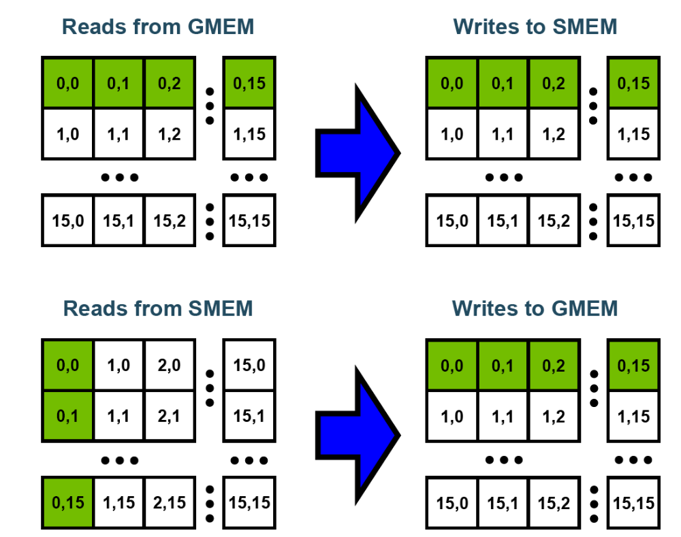
Coalesced Transpose: Access Patterns

Slide 50
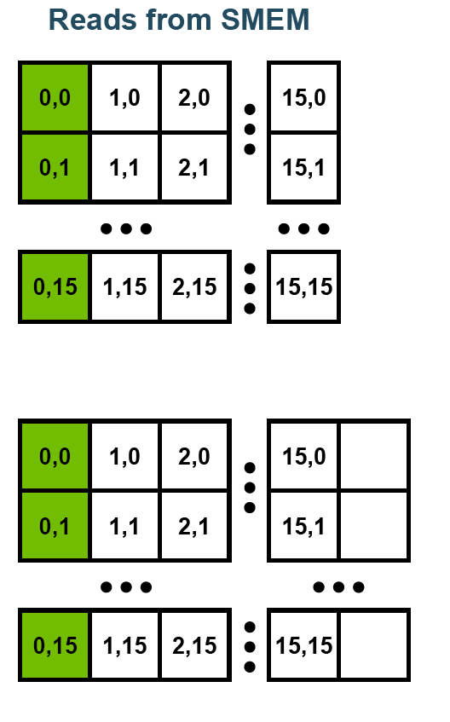
Avoiding Bank Conflicts in Shared Memory
Threads read SMEM with stride
  16x16-way bank conflicts
  16x slower than no conflicts
SolutionAllocate an “extra” column
  Read stride = 17
  Threads read from consecutive banks

Slide 51
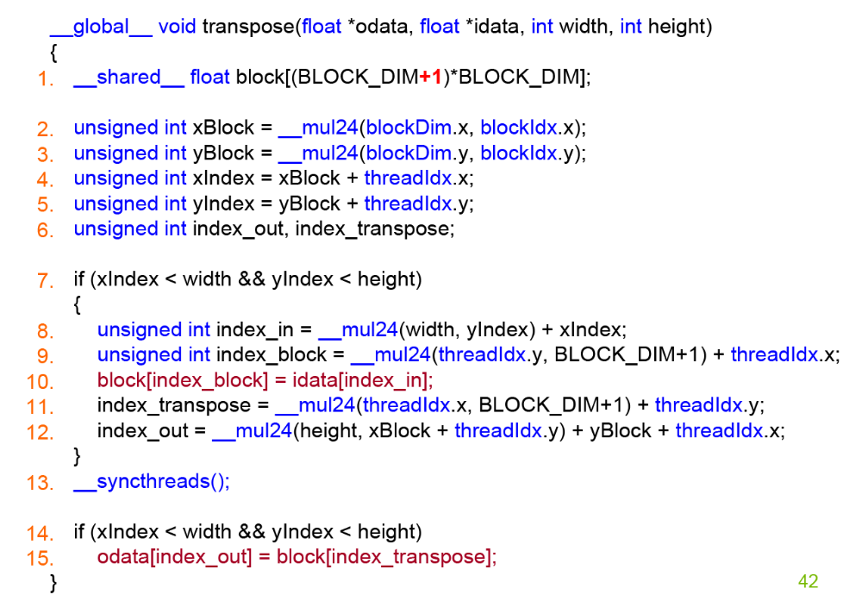
Coalesced Transpose

Slide 52
Transpose Measurements
Average over 10K runs
16x16 blocks
128x128 → 1.3x
  Optimized: 23 μs
  Naïve: 17.5 μs
512x512 → 8.0x
  Optimized: 108 μs
  Naïve: 864.6 μs
1024x1024 → 10x
  Optimized: 423.2 μs
  Naïve: 4300.1 μs
4096x4096 →
  Optimized:
  Naïve:

Slide 53
Transpose Detail
512x512
Naïve: 864.1
Optimized w/ shader memory: 430.1
Optimized w/ extra float per row: 111.4

